Slide 1

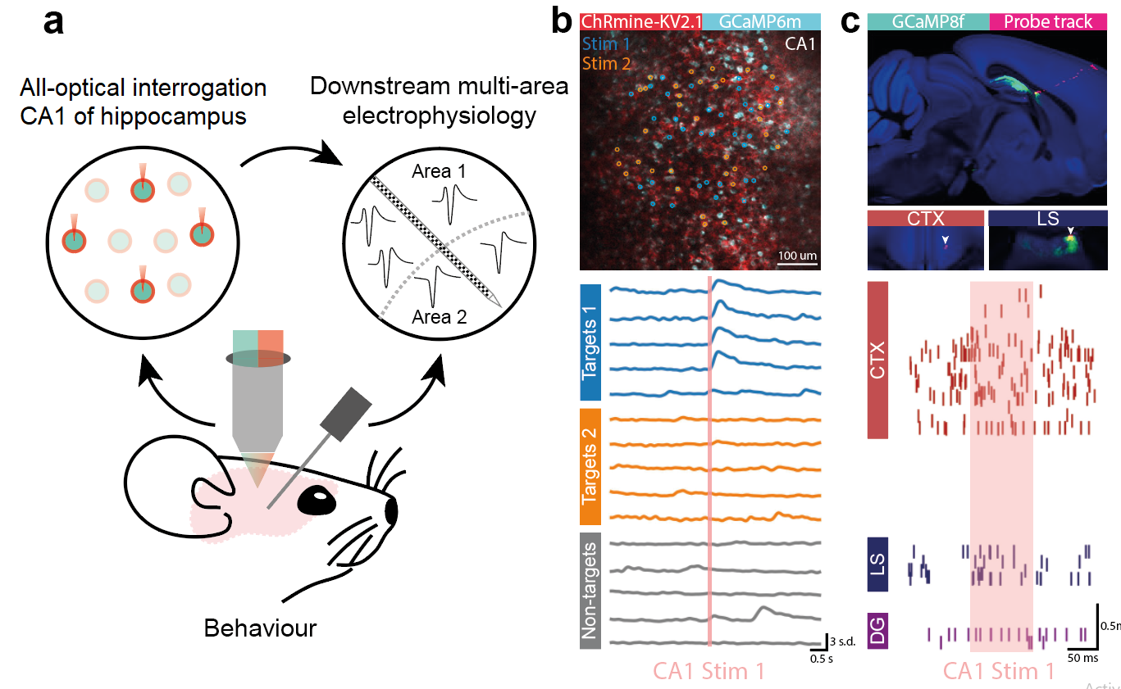
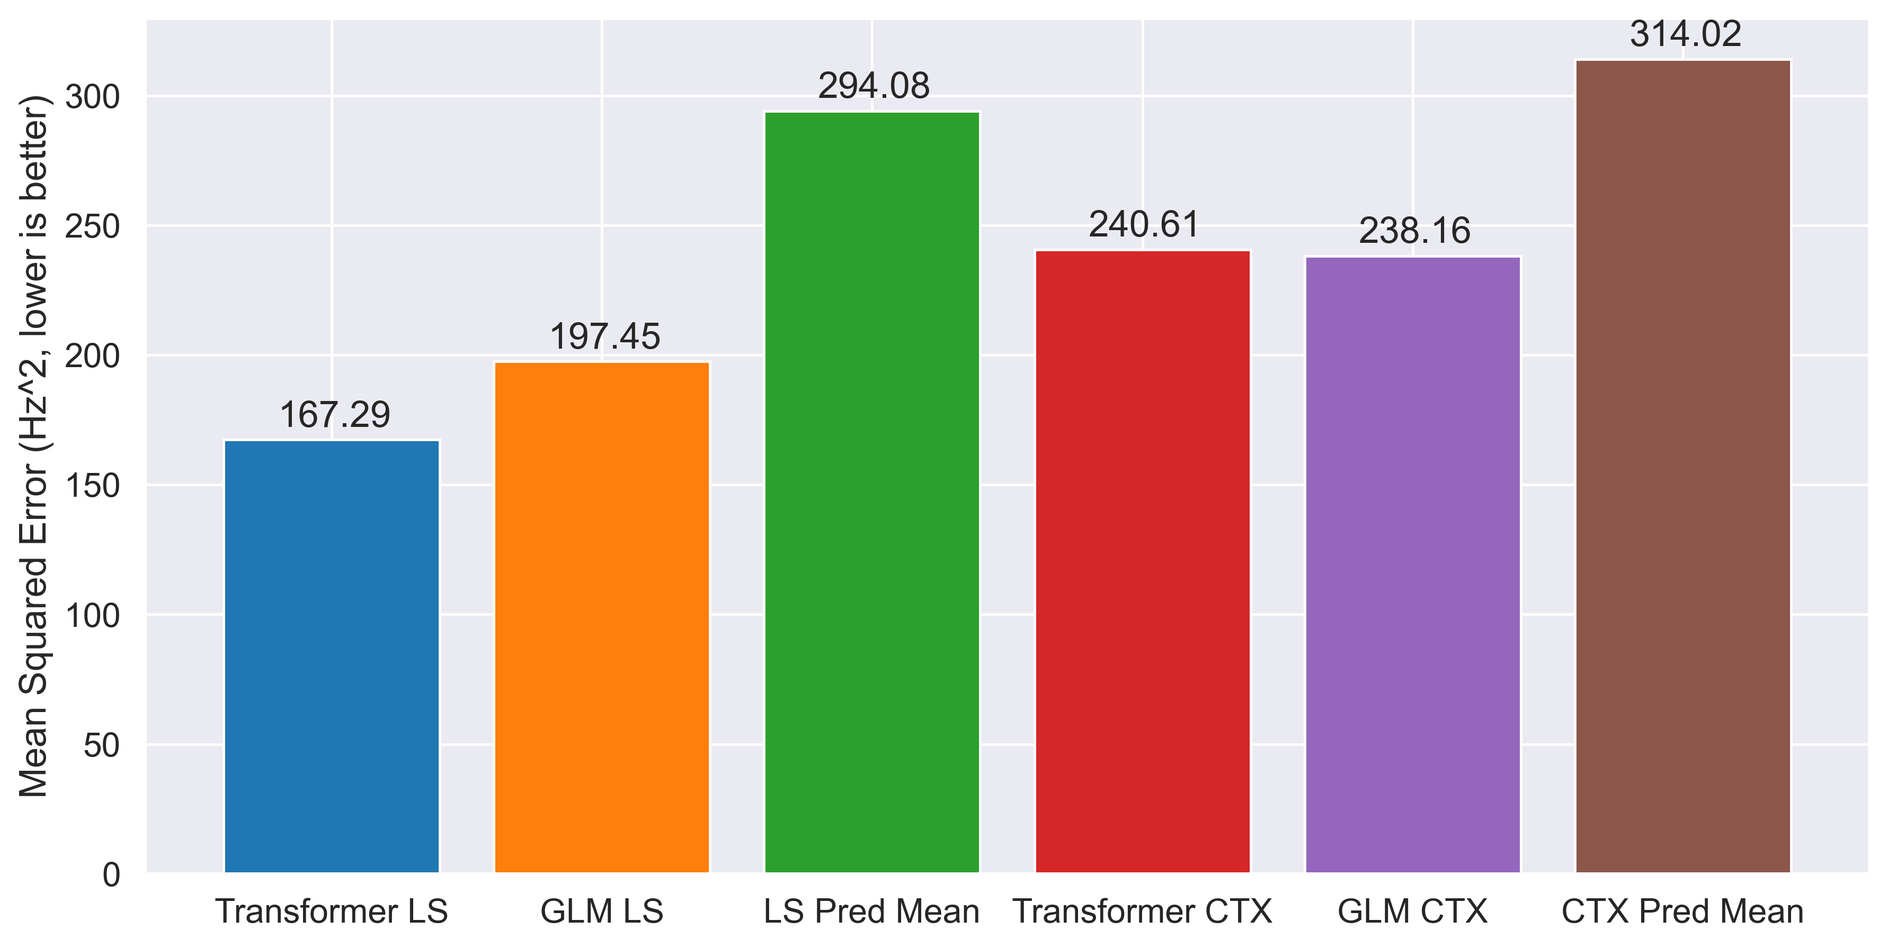
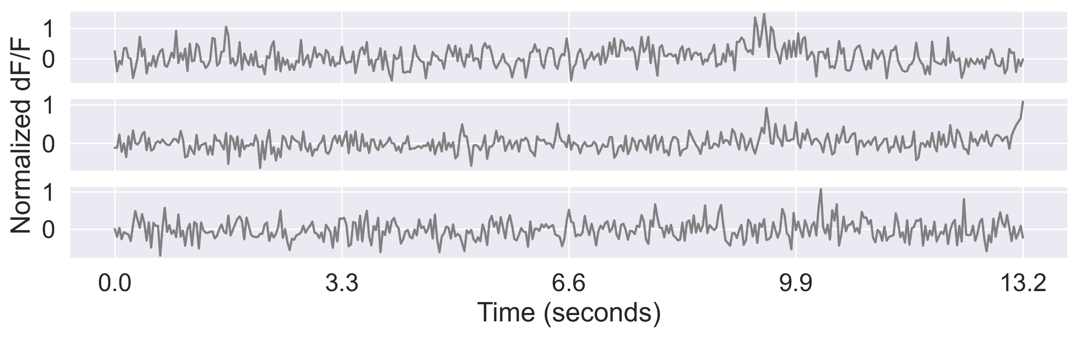
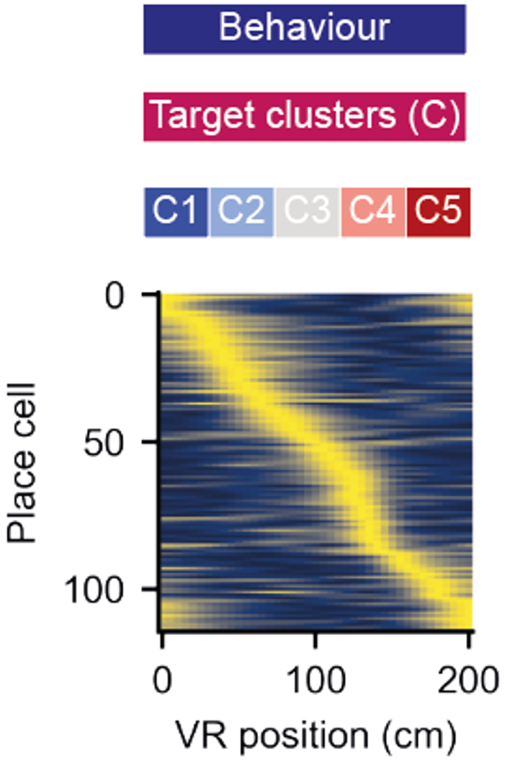
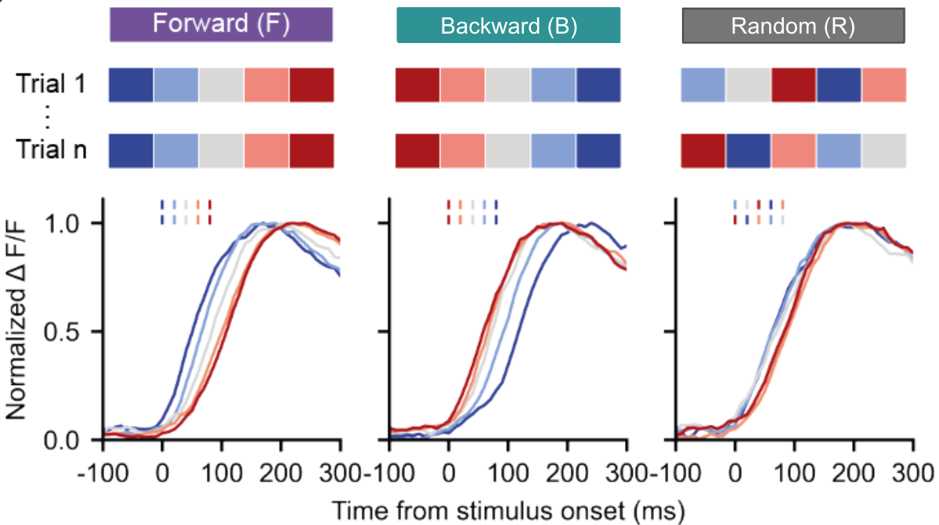
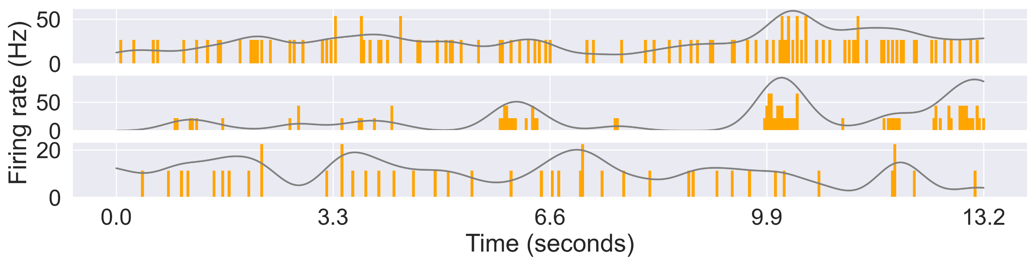
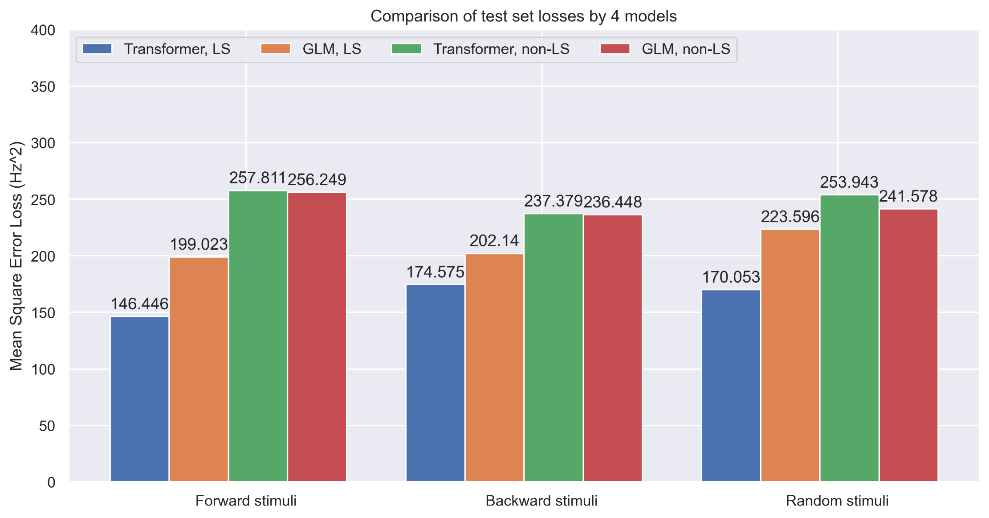
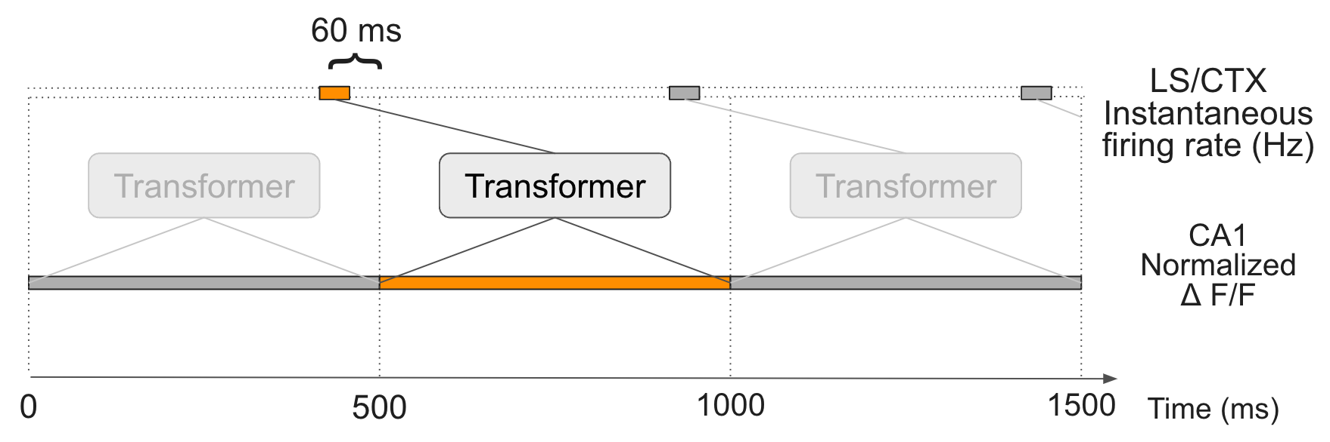
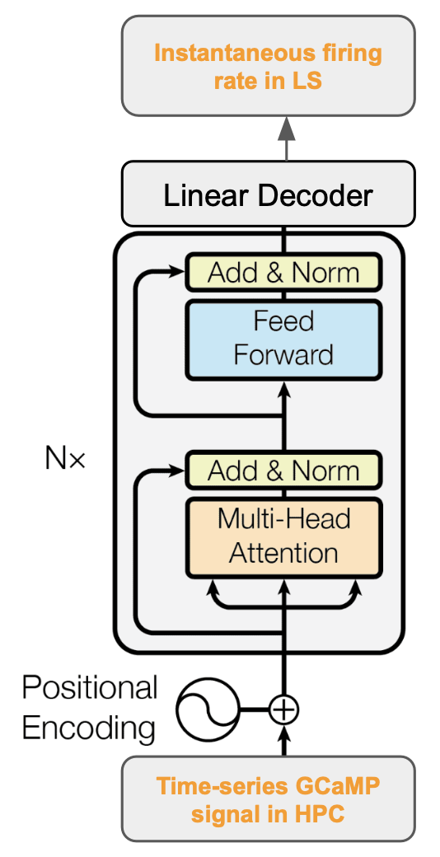
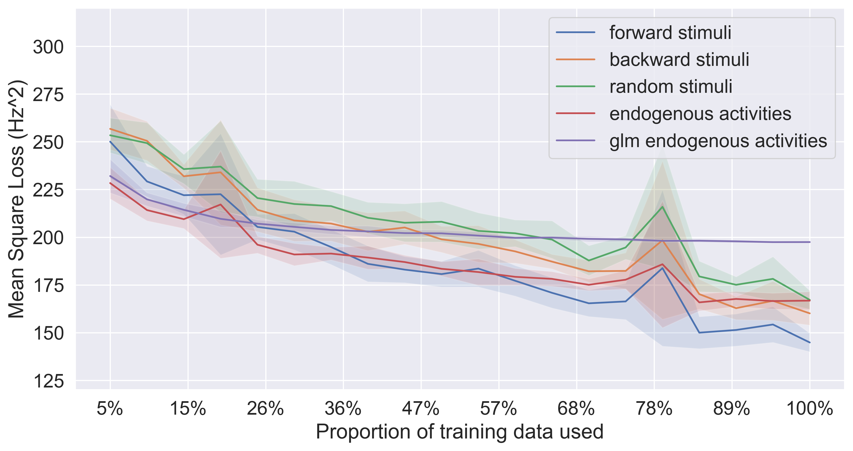
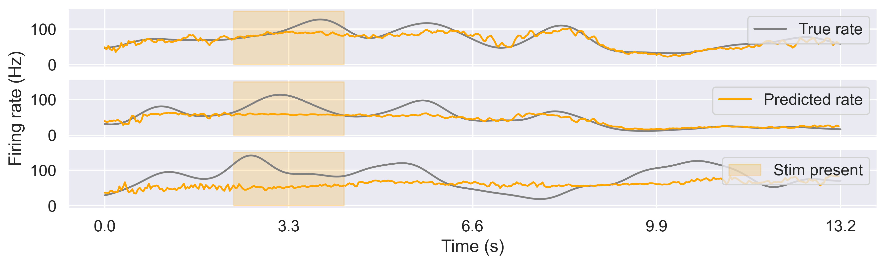
Transformer Learns Neural Circuit with Diverse Stimulation Patterns
S. Liu^{1,2}; A. Mavor-Parker³; E. Baumler⁴; M. Buchholz⁴ & C.Barry^{1,2}
¹ UCL Dept of Cell & Developmental Biology. ² The Sainsbury Wellcome Centre. ³ UCL Centre for Artificial Intelligence. ⁴ The Wolfson Institute for Biomedical Research. Equal contribution. Correspondence to caswell.barry@ucl.ac.uk
Introduction. To understand the brain, we need to understand the computations performed by neural circuits. One approach is to use observed experimental data to distil the neural function into artificial neural networks. This requires access to neural data from the input and output neurons of a neural circuit.
We performed simultaneous neural recording from the CA1 area of the hippocampus as well as the lateral septum (LS) and cortical areas (CTX) - the former being a significant projection target of CA1. We then trained sets of transformer neural network models on the CA1 – LS circuit. The trained models demonstrated competitive accuracy and efficiency compared to baseline GLMs, and are able to generalise when random stimuli are injected optically into the input neurons.
Simultaneous neural recordings
error metric. Training the transformer is also more data and compute efficient, as detailed below.
We simultaneously recorded fluorescence signals (two-photon Ca++ imaging) in hippocampus CA1 as well as multi-unit spiking activities in the LS and CTX (NeuroPixel 2.0).
387 CA1 neurons were interrogated via GCaMP, 77 neurons were recorded via Neuropixel probes, of which 13 were identified from LS.
CA1
HPC 7
HPC 126
HPC 268
Light-activated stimuli injection
To test how well a trained transformer model can generalise predictions to non-endogenous activities, we injected three types of stimuli: forward, reverse and random, based on hippocampal replay sequence, using all-optical stimulation.
CTX 15
CTX 67
LS 3
Transformer learns endogenous activities
Leveraging the power of transformer neural networks, we use 15 bins (500 ms) of CA1 fluorescence signals to predict 1 bin of LS and CTX neuron firing rates. Because of the exponential decay time of fluorescence signal, the optimal offset was found to be -60 ms using a generalized linear model (GLM).
Data efficiency
We tested the performance of the transformer model trained on randomly sampled smaller proportions of the available endogenous activities.
We trained two transformer models, using 43 mins of CA1 activities to predict LS (where direct projections exist) and CTX (where no direct projections exist) endogenous activities, respectively.
The transformer features multi-head attention which was used in natural languages, can selectively focus on activities features in the CA1 neurons with positional information, and allows parallel processing.
LS 4
LS 11
CTX 57
Transformer outperforms GLM at every proportion and continues to improve as more data is provided, whereas GLM flattens out.
Conclusions
Optical and electrophysiology recording data enables computational modelling of the hippocampus – lateral septum circuit in mice.
Transformer neural networks can be trained on endogenous activities to learn the functional mapping of this circuit.
Trained model generalises to neural activities where light-activated stimuli is injected externally.
Transformer outperforms baseline models in all scenarios.
Training transformer is time saving and data efficient, and continues to improve when more data is provided.
We observed predictions on many CTX neurons reduces to the moving average. This is likely due to there being no connections established from the hippocampus.
The trained transformer predicts the CA1 – LS circuit 15% better than a baseline GLM and 43% better than predicting the mean alone, under the mean squared
References
Ólafsdóttir, H. F., Bush, D., & Barry, C. (2018). The role of hippocampal replay in memory and planning. Current Biology, 28(1), R37-R50.
Risold, P. Y., & Swanson, L. W. (1997). Connections of the rat lateral septal complex. Brain research reviews, 24(2-3), 115-195.
Vaswani, A., Shazeer, N., Parmar, N., Uszkoreit, J., Jones, L., Gomez, A. N., ... & Polosukhin, I. (2017). Attention is all you need. Advances in neural information processing systems, 30.

